Slide 1
The Progressive Presidents

Slide 2
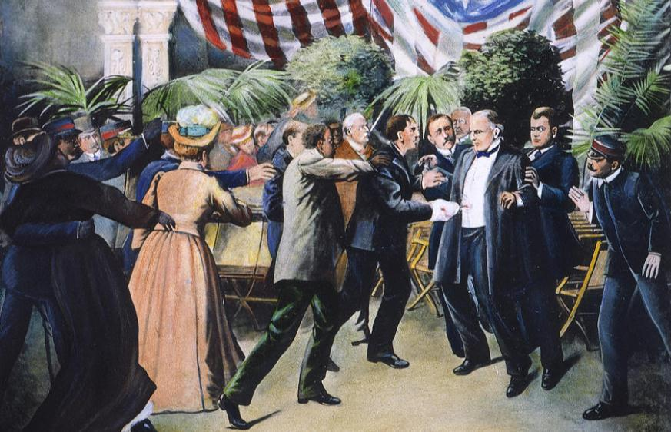
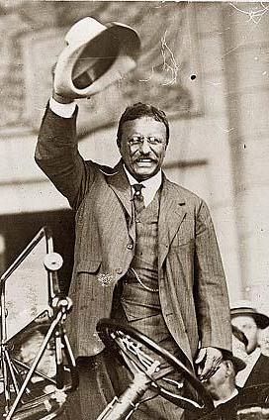
In 1901, Republican President William McKinley was assassinated...
…Vice President Theodore Roosevelt became president

Slide 3
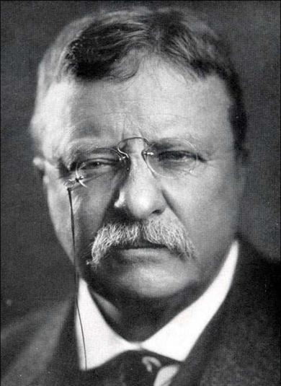
Theodore Roosevelt was a different kind of president because he thought the gov’t ought to take responsibility for the welfare of the people
“It is the duty of the president to act upon the theory that he is the steward of the people, and…to assume that
he has the legal right to do whatever the needs of the people demand, unless the Constitution or the laws explicitly forbid him to do it”
The “bully pulpit”…..

Slide 4
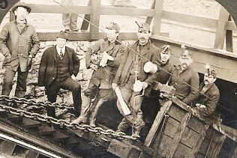
Theodore Roosevelt was a different kind of president because he thought the gov’t ought to take responsibility for the welfare of the people
In 1902, TR negotiated a
“Square Deal” between striking anthracite coal miners and management
Notes:
In 1902, the United Mine Workers went on strike to demand higher pay & an eight-hour work day
(a) The anthracite coal strike lasted 11 months & threatened the nation as winter approached
(b) Unlike the Gilded Age presidents, TR did not side with the owners & break up the strike
(c) TR forced both sides to arbitrate or face gov’t seizure of the coal mine
(d) The result was a “square deal” for labor (higher wages) & owners (no formal recognition of the union)

Slide 5
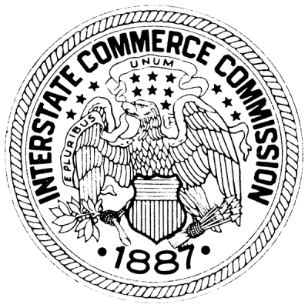
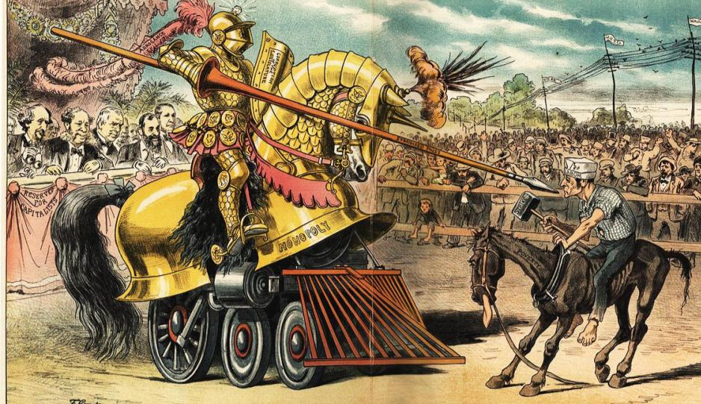
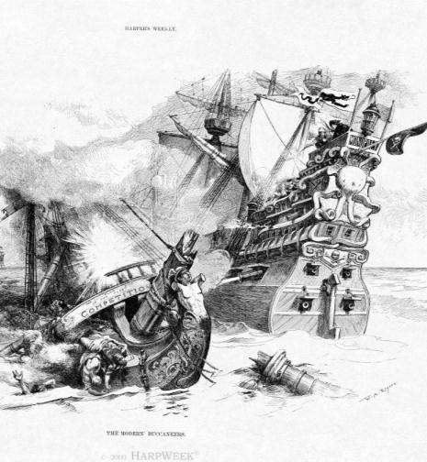
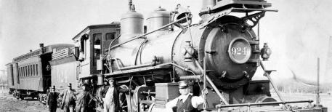
Throughout the Gilded Age, laissez-faire policies by the national government led to powerful monopolies and unfair working conditions for laborers
Congress created the Interstate Commerce Commission (ICC) in 1886 to regulate railroads…
…and passed the Sherman Anti-Trust Act
in 1890 to regulate companies that
restrict trade
But neither was used
to control monopolies during the Gilded Age
REGULATION

Slide 6
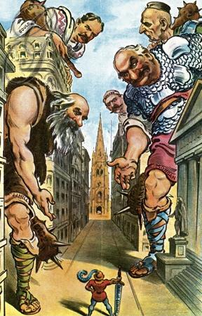
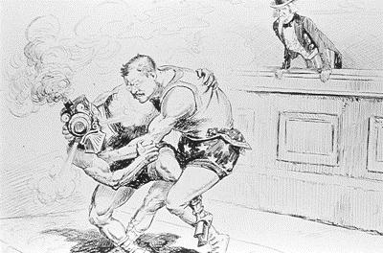
Roosevelt was the first president to regulate
big business and break up corporate monopolies
He became known as a “trustbuster” when he used the Sherman Anti-Trust Act
to break up the Northern Securities Company in 1902

Slide 7
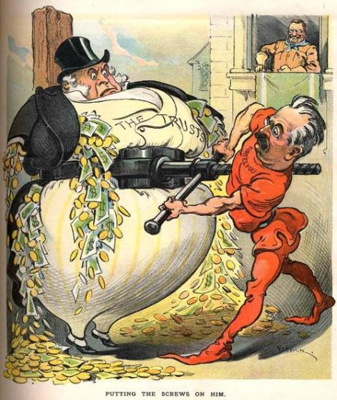
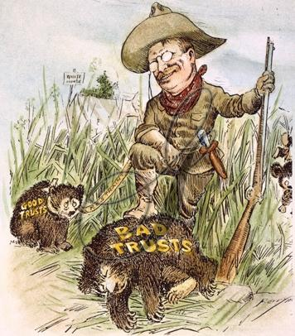
TR “busted” 25 other corporate monopolies during his presidency
But, he saw the benefit of efficient monopolies, but wanted to control bad trusts
RESTRAINT

Slide 8
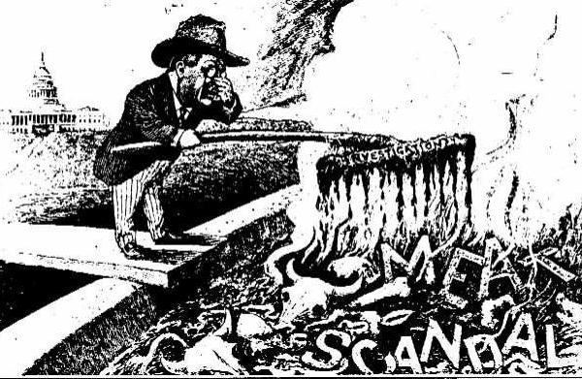
When Upton Sinclair wrote The Jungle in 1906, President Roosevelt pressured Congress
to create consumer safety laws
Congress passed the Meat Inspection Act in 1906

Slide 9
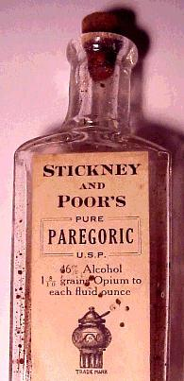
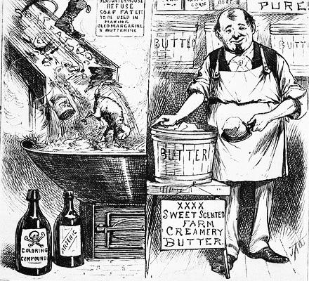
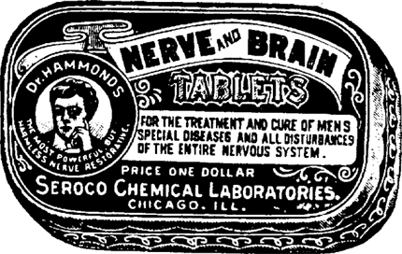
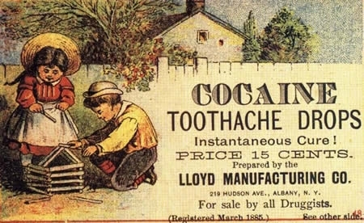
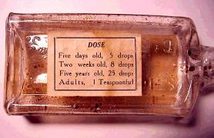
Congress passed the Pure Food and Drug Act in 1906 to ban harmful products and end false medical claims

Slide 10
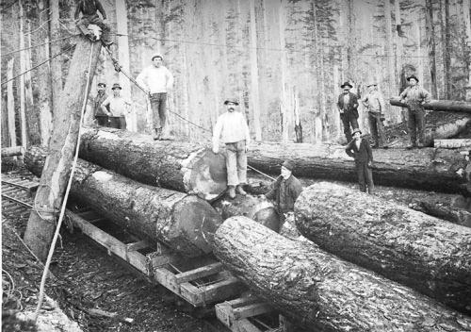
During the Gilded Age, corporations clear-cut forests and exploited America’s natural resources

Slide 11
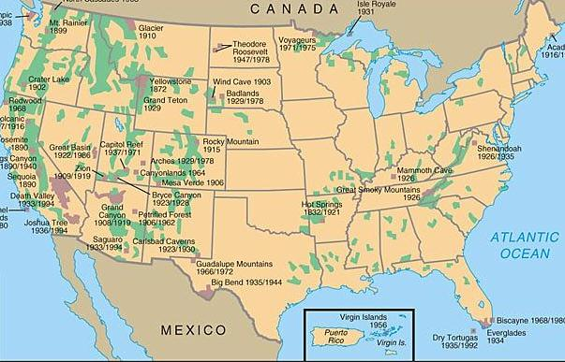

Theodore Roosevelt began the first national environmental conservation program
The government protected 195 million acres of land as national parks or forests

Slide 12
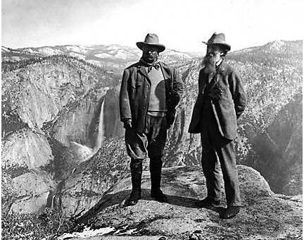
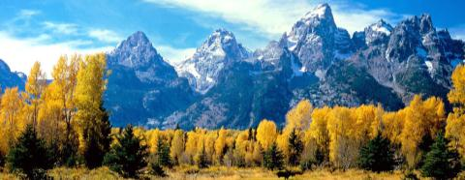
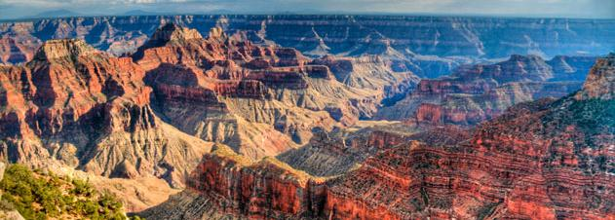
The Reclamation Service placed natural resources (oil, trees, coal) under federal protection

Slide 13
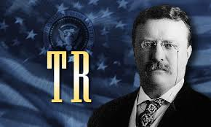
3 C’s:
Consumer protection,
Control of Corporations,
Conservation

Slide 14
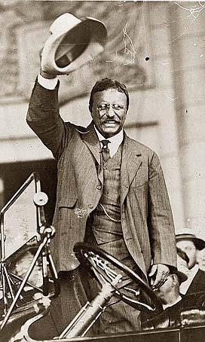
  In 1908, TR decided not to run for a third term
Roosevelt’s presidency from 1901 to 1909 changed the United States
  First time, the government assumed responsibility for the welfare of all citizens, regulated big business, and protected the environment
  His foreign policy helped increase American influence in the world
  and led to the construction of the Panama Canal

Slide 15
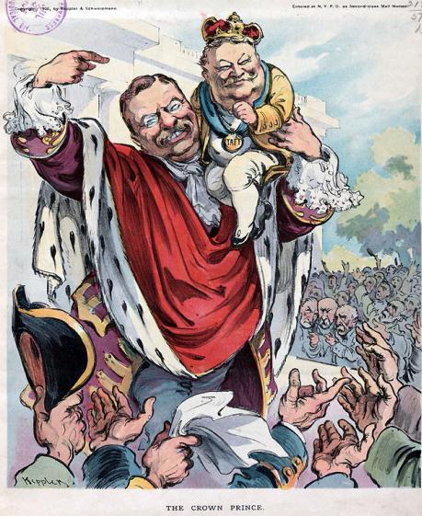
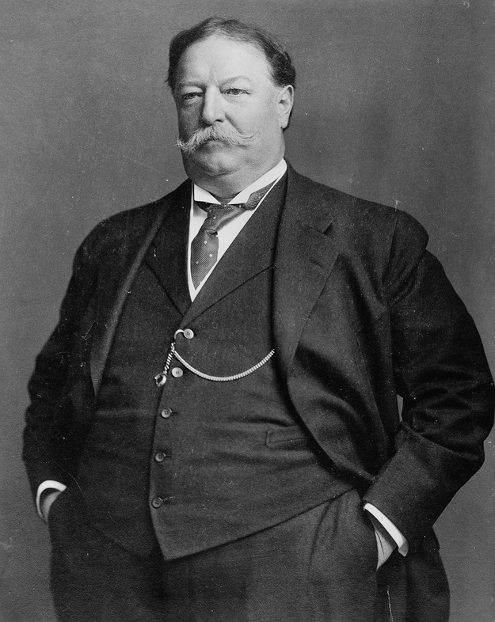
  When Theodore Roosevelt did not to run for a third term in 1908, he helped William Howard Taft win the presidency to continue his progressive agenda

Slide 16
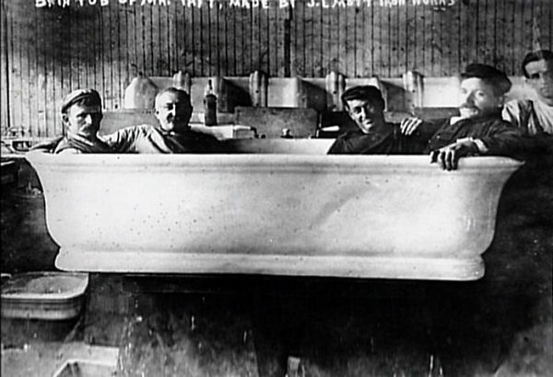

Slide 17
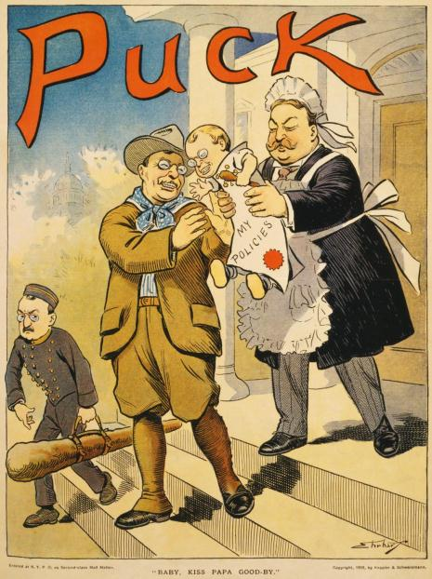
  Like TR, Taft pushed for progressive reforms
As president, Taft
broke up twice as many monopolies as Roosevelt
Taft helped establish the Children’s Bureau, the Department of Labor, and child labor laws
He helped create safety codes for coal miners and railroad workers

Slide 18
But, Taft sometimes sided with the
conservative wing of the Republican Party
Taft angered progressive Republicans when he supported a high tariff which helped
large corporations
Taft allowed 1 million acres of Roosevelt
had set aside as conservation forests
to be sold to businesses

Slide 19
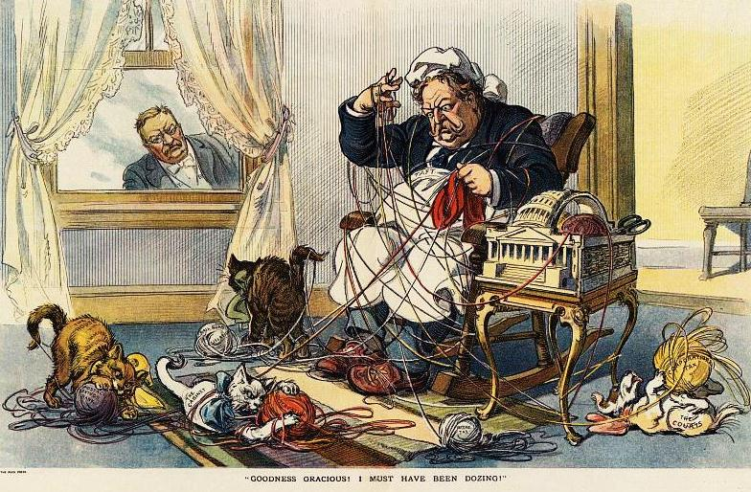
Theodore Roosevelt and progressive politicians were disappointed in Taft’s performance

Slide 20
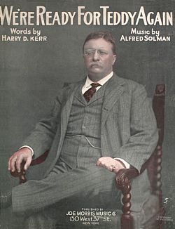
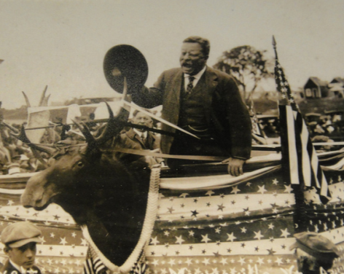
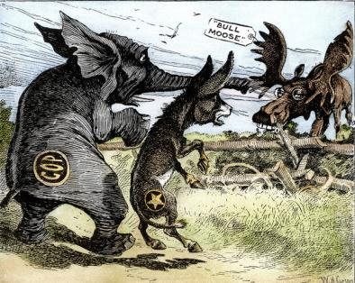
TR decided to run for president in 1912 but the Republican Party picked Taft as their candidate…
…so Roosevelt formed a
new political party called the Progressive Party
(“Bull Moose Party”)
“I’m feeling as fit as a bull moose”

Slide 21
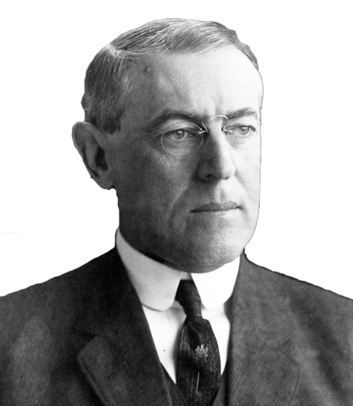
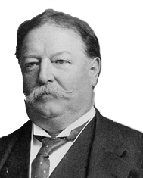
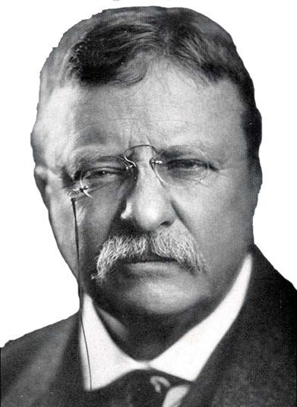
The election of 1912 was a three way race
William Howard Taft ran on the Republican ticket
Democrats ran
New Jersey governor Woodrow Wilson
TR ran as a Progressive Bull Moose

Slide 22
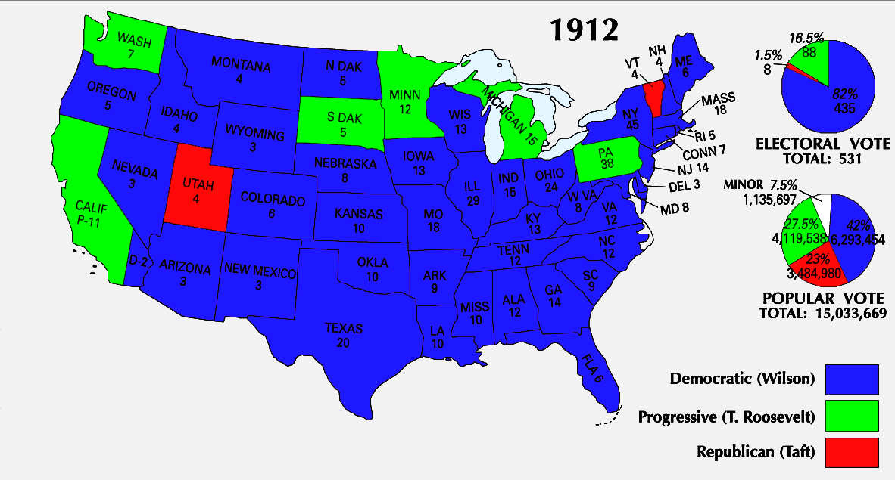
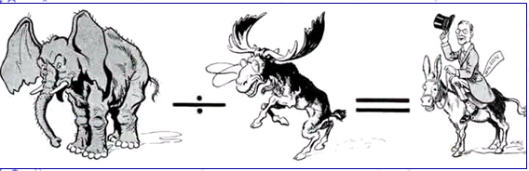
Republican voters were divided between Taft and Roosevelt…
…and Democrat Woodrow Wilson won the election of 1912
Republicans divided by a Bull moose
equals a Democratic victory!

Slide 23
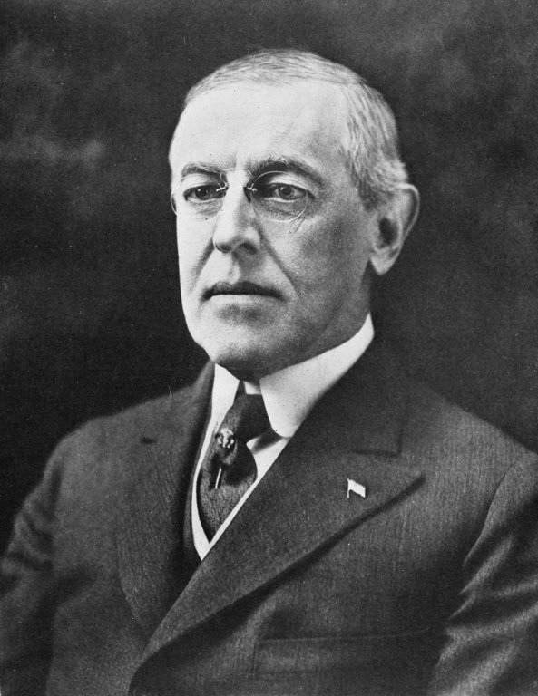
President Woodrow Wilson oversaw
a great wave of progressive reforms
16th Amendment created the first national income tax
17th Amendment allowed for the direct-election of
U.S. Senators
18th Amendment outlawed alcohol (prohibition)
19th Amendment granted women’s suffrage
“Progressive Amendments”

Slide 24
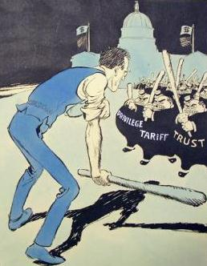
Wilson regulated big business by pushing for the Clayton
Anti-Trust Act (protected workers’ right to strike) and…
…created the Federal Trade Commission to monitor unfair business practices

Slide 25
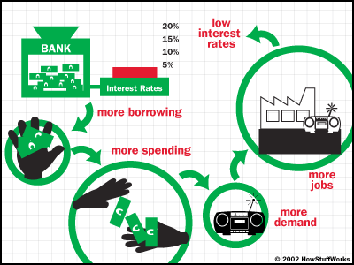
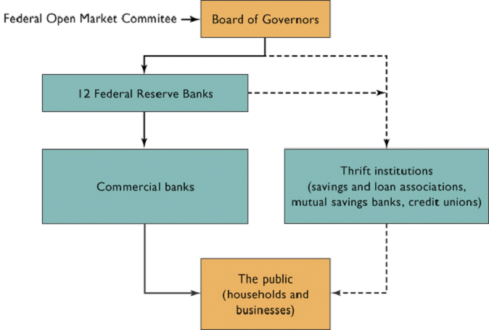
Woodrow Wilson created the Federal Reserve system in 1913 to regulate the economy by adjusting the money supply and interest rates
The “Fed” regulates the amount of money in circulation to help keep the economy strong
Time video:
How the Fed Works
St Louis Fed video:
In Plain English
Notes:
Time video: How the Fed Works
http://www.tme.com/time/video/player/0,32068,57544286001_1948059,00.html
St. Louis Fed video: In plain English
http://www.stlouisfed.org/education_resources/inplainenglishvideo.cfm

Slide 26
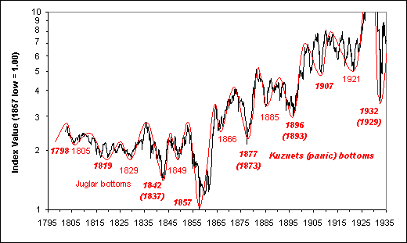
Financial Panics in American History

Slide 27
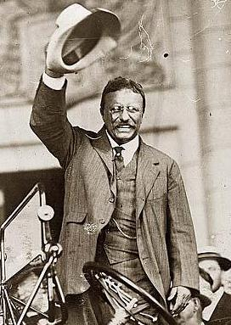
The Progressive Era (1890-1920) brought major changes to the United States
For the first time, the government began regulating big business
Working and living conditions improved
Women’s suffrage and new state ballot reforms increased democracy
for the people
But, America’s involvement in
World War I brought an end to the Progressive Era

